Slide 1
Chapter 2:
Using Data

Slide 2
Objectives
Declare and use constants and variables
Use integer data types
Use the boolean data type
Use floating-point data types
Use the char data type
Use the Scanner class to accept keyboard input
Java Programming, Eighth Edition

Slide 3
Objectives (cont’d.)
Use the JOptionPane class to accept GUI input
Perform arithmetic
Understand type conversion
Java Programming, Eighth Edition

Slide 4
Declaring and Using Constants and Variables
Constant
  Cannot be changed while program is running
Literal constant
  Value taken literally at each use
Numeric constant
  As opposed to a literal constant
Unnamed constant
  No identifier is associated with it
Java Programming, Eighth Edition

Slide 5
Declaring and Using Constants and Variables (cont’d.)
Variable
  A named memory location
  Used to store a value
  Can hold only one value at a time
  Its value can change
Data type
  A type of data that can be stored
  How much memory an item occupies
  What types of operations can be performed on data
Java Programming, Eighth Edition

Slide 6
Declaring and Using Constants and Variables (cont’d.)
Primitive type
  A simple data type
Reference types
  More complex data types
Java Programming, Eighth Edition

Slide 7
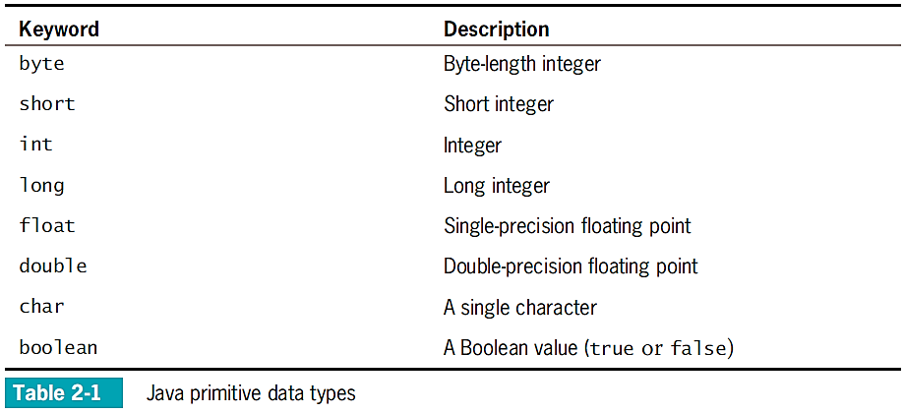
Declaring and Using Constants and Variables (cont’d.)
Java Programming, Eighth Edition

Slide 8
Declaring Variables
Name variables
  Use naming rules for legal class identifiers
Variable declaration
  A statement that reserves a named memory location
  Includes:
    Data type
    Identifier
    Optional assignment operator and assigned value
    Ending semicolon
Java Programming, Eighth Edition

Slide 9
Declaring Variables (cont’d.)
Assignment operator
  The equal sign (=)
  The value to the right is assigned to the variable on the left
Initialization
  An assignment made when declaring a variable
Assignment
  An assignment made after a variable is declared
Associativity
  The order in which operands are used with operators
Java Programming, Eighth Edition

Slide 10
Declaring Variables (cont’d.)
Declare multiple variables of the same type in separate statements on different lines
  int myAge = 25;
  int yourAge = 19;
When declaring variables of different types, you must use a separate statement for each type
Java Programming, Eighth Edition

Slide 11
Declaring Named Constants
A named constant:
  Should not change during program execution
  Has a data type, name, and value
  Has a data type preceded by the keyword final
  Can be assigned a value only once
  Conventionally is given identifiers using all uppercase letters
Java Programming, Eighth Edition

Slide 12
Declaring Named Constants (cont’d.)
Reasons for using named constants:
  Make programs easier to read and understand
  Enable you to change a value at one location within a program
  Reduce typographical errors
  Stand out as separate from variables
Java Programming, Eighth Edition

Slide 13
The Scope of Variables and Constants
Scope
  The area in which a data item is visible to a program, and in which you can refer to it using its simple identifier
A variable or constant is in scope from the point it is declared
  Until the end of the block of code where the declaration lies
Java Programming, Eighth Edition

Slide 14
Concatenating Strings to Variables and Constants
print() or println() statement
  Use alone or in combination with a String
Concatenated
  A numeric variable is concatenated to a String using the plus sign
  The entire expression becomes a String
The println() method can accept a number or String
Java Programming, Eighth Edition

Slide 15
Concatenating Strings to Variables and Constants (cont’d.)
Use a dialog box to display values
  JOptionPane.showMessageDialog()
  Does not accept a single numeric variable
Null String
  An empty string: ""
Java Programming, Eighth Edition

Slide 16
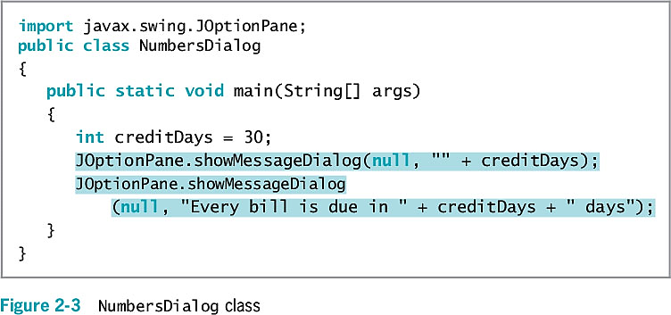
Concatenating Strings to Variables and Constants (cont’d.)
Java Programming, Eighth Edition

Slide 17
Pitfall: Forgetting That a Variable Holds One Value at a Time
Each constant can hold only one value for the duration of the program
Switch values of two variables
  Use a third variable
Java Programming, Eighth Edition

Slide 18
Learning About Integer Data Types
int data type
  Stores an integer, or whole number
  Value from –2,147,483,648 to +2,147,483,647
Variations of the integer type
  byte
  short
  long
Choose appropriate types for variables
Java Programming, Eighth Edition

Slide 19
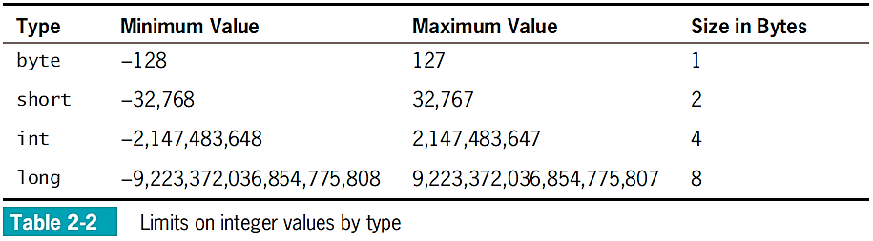
Learning About Integer Data Types (cont’d.)
Java Programming, Eighth Edition

Slide 20
Using the boolean Data Type
Boolean logic
  Based on true-or-false comparisons
boolean variable
  Can hold only one of two values
  true or false
boolean isItPayday = false;
Relational operator (comparison operator)
  Compares two items
Java Programming, Eighth Edition

Slide 21
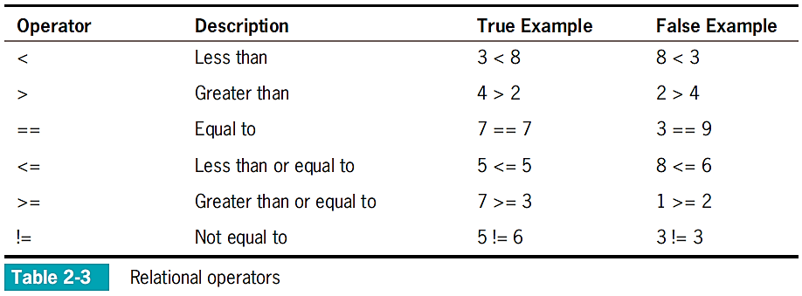
Using the boolean Data Type (cont’d.)
Java Programming, Eighth Edition

Slide 22
Learning About Floating-Point
Data Types
Floating-point number
  Contains decimal positions
Floating-point data types
  float
  double
Significant digits
  Refers to mathematical accuracy
Java Programming, Eighth Edition

Slide 23
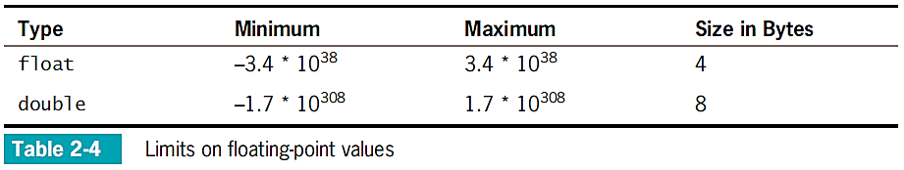
Learning About Floating-Point
Data Types (cont’d.)
Java Programming, Eighth Edition

Slide 24
Using the char Data Type
char data type
  Holds any single character
Place constant character values within single quotation marks
char myMiddleInitial = 'M';
String
  A built-in class
  Stores and manipulates character strings
  String constants are written between double quotation marks
Java Programming, Eighth Edition

Slide 25
Using the char Data Type (cont’d.)
Escape sequence
  Begins with a backslash followed by a character
  Represents a single nonprinting character
  char aNewLine = '\n';
To produce console output on multiple lines in the command window, use one of these options:
  Use the newline escape sequence
  Use the println() method multiple times
Java Programming, Eighth Edition

Slide 26
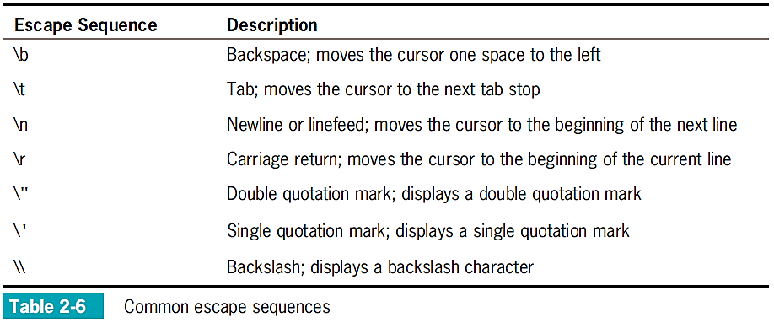
Using the char Data Type (cont’d.)
Java Programming, Eighth Edition

Slide 27
Using the Scanner Class to Accept Keyboard Input
System.in object
  Standard input device
  Normally the keyboard
  Access using the Scanner class
Scanner object
  Breaks input into units called tokens
Java Programming, Eighth Edition

Slide 28
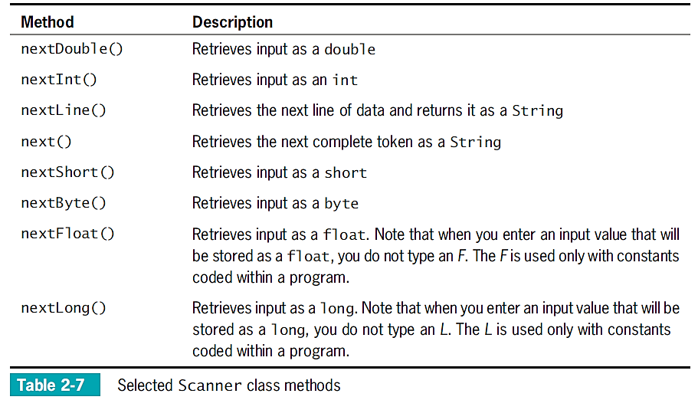
Using the Scanner Class to Accept Keyboard Input (cont’d.)
Java Programming, Eighth Edition

Slide 29
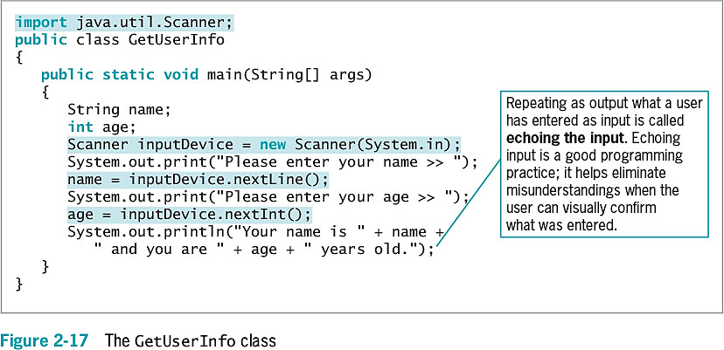
Using the Scanner Class to Accept Keyboard Input (cont’d.)
Java Programming, Eighth Edition

Slide 30
Pitfall: Using nextLine() Following One of the Other Scanner Input Methods
There is a problem when using one numeric Scanner class retrieval method or next()method before using the nextLine()method
Keyboard buffer
  Location in memory that stores all keystrokes, including Enter
To avoid issues, add an extra nextLine()method call to retrieve the abandoned Enter key character after numeric or next() inputs
Java Programming, Eighth Edition

Slide 31
Using the JOptionPane
Class to Accept GUI Input
Dialog boxes used to accept user input:
  Input dialog box
  Confirm dialog box
Java Programming, Eighth Edition

Slide 32
Using Input Dialog Boxes
Input dialog box
  Asks a question
  Provides a text field in which the user can enter a response
showInputDialog() method
  Six overloaded versions
  Returns a String representing a user’s response
Prompt
  A message requesting user input
Java Programming, Eighth Edition

Slide 33
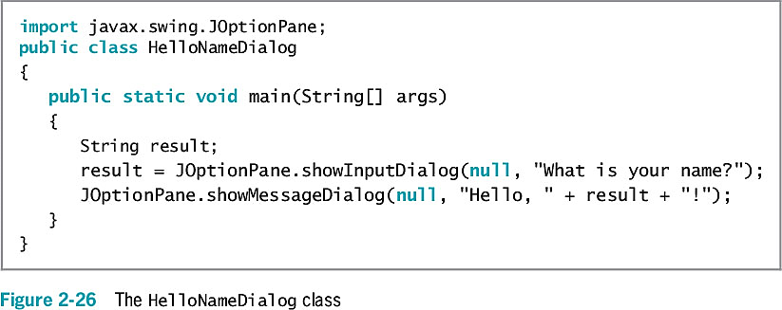
Using Input Dialog Boxes (cont’d.)
Java Programming, Eighth Edition

Slide 34
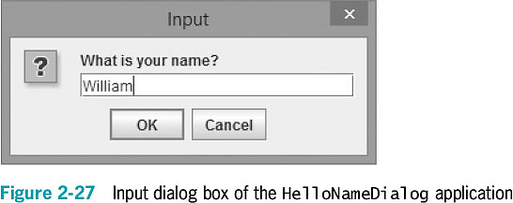
Using Input Dialog Boxes (cont’d.)
Java Programming, Eighth Edition

Slide 35
Using Input Dialog Boxes (cont’d.)
showInputDialog()
  One version requires four arguments:
    Parent component
    Message
    Title
    Type of dialog box
Convert String to int or double
  Use methods from the built-in Java classes Integer and Double
Java Programming, Eighth Edition

Slide 36
Using Input Dialog Boxes (cont’d.)
Type-wrapper classes
  Each primitive type has a corresponding class contained in the java.lang package
  Include methods to process primitive type values
      Integer.parseInt()
      Double.parseDouble()
Java Programming, Eighth Edition

Slide 37
Using Confirm Dialog Boxes
Confirm dialog box
  Displays the options Yes, No, and Cancel
showConfirmDialog() method in JOptionPane class
  Four overloaded versions are available
  Returns integer containing either:
      JOptionPane.YES_OPTION
      JOptionPane.NO_OPTION
      JOptionPane.CANCEL_OPTION
Java Programming, Eighth Edition

Slide 38
Using Confirm Dialog Boxes (cont’d.)
You can create a confirm dialog box with five arguments:
  Parent component
  Prompt message
  Title
  Integer that indicates which option button to show
  Integer that describes the kind of dialog box
Java Programming, Eighth Edition

Slide 39
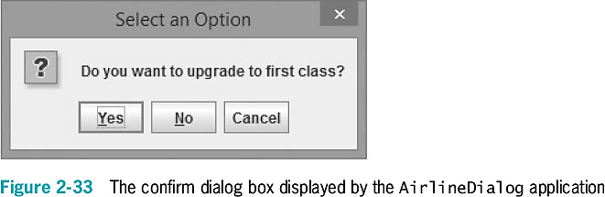
Using Confirm Dialog Boxes (cont’d.)
Java Programming, Eighth Edition

Slide 40
Performing Arithmetic
Standard arithmetic operators
  Perform calculations with values in programs
Operand
  A value used on either side of an operator
Integer division
  Involves integer constants or integer variables
  The result is an integer
  Any fractional part of the result is lost
Java Programming, Eighth Edition

Slide 41
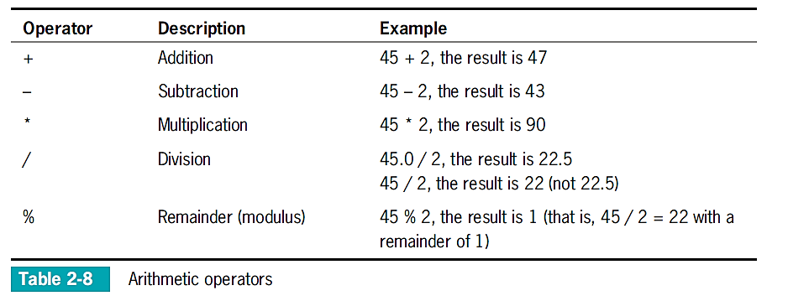
Performing Arithmetic (cont’d.)
Java Programming, Eighth Edition

Slide 42
Associativity and Precedence
Operator precedence
  The rules for the order in which parts of mathematical expressions are evaluated
  First multiplication, division, and remainder (modulus), then addition or subtraction
Java Programming, Eighth Edition

Slide 43
Writing Arithmetic Statements Efficiently
Avoid unnecessary repetition of arithmetic statements
Example of inefficient calculation:
  stateWithholding = hours * rate * STATE_RATE;
  federalWithholding = hours * rate * FED_RATE;
Example of efficient calculation:
  grossPay = hours * rate;
  stateWithholding = grossPay * STATE_RATE;
  federalWithholding = grossPay * FED_RATE;
Java Programming, Eighth Edition

Slide 44
Pitfall: Not Understanding Imprecision in Floating-Point Numbers
Integer values are exact
  But floating-point numbers frequently are only approximations
Imprecision leads to several problems
  Floating-point output might not look like what you expect or want
  Comparisons with floating-point numbers might not be what you expect or want
Java Programming, Eighth Edition

Slide 45
Understanding Type Conversion
Arithmetic with variables or constants of the same type
  The result of arithmetic retains the same type
Arithmetic operations with operands of unlike types
  Java chooses the unifying type for the result
Unifying type
  The type to which all operands in an expression are converted for compatibility
Java Programming, Eighth Edition

Slide 46
Automatic Type Conversion
Automatically converts nonconforming operands to the unifying type
Order for establishing unifying types between two variables (highest to lowest):
  double
  float
  long
  int
Java Programming, Eighth Edition

Slide 47
Explicit Type Conversions
Type casting
  Forces a value of one data type to be used as a value of another data type
Cast operator
  Place desired result type in parentheses
  Using a cast operator is an explicit conversion
You do not need to perform a cast when assigning a value to a higher unifying type
Java Programming, Eighth Edition

Slide 48
You Do It
Declaring and Using a Variable
Working with Integers
Working with the char Data Type
Accepting User Input
Using Arithmetic Operators
Implicit and Explicit Casting
Java Programming, Eighth Edition

Slide 49
Don’t Do It
Don’t attempt to assign a literal constant floating-point number
Don’t forget precedence rules
Don’t forget that integer division results in an integer
Don’t attempt to assign a constant decimal value to an integer using a leading 0
Don’t use a single equal sign (=) in a Boolean comparison for equality
Don’t try to store a string of characters in a char variable
Java Programming, Eighth Edition

Slide 50
Don’t Do It (cont’d.)
Don’t forget that when a String and a numeric value are concatenated, the resulting expression is a string
Don’t forget to consume the Enter key after numeric input using the Scanner class when a nextLine()method call follows
Don’t forget to use the appropriate import statement when using the Scanner or JOptionPane class
Java Programming, Eighth Edition

Slide 51
Summary
Variables
  Named memory locations
Primitive data types
Standard arithmetic operators for integers:
  +, _, *, /, and %
Boolean type
  true or false value
Relational operators:
  >, <, ==, >=, <=, and !=
Java Programming, Eighth Edition

Slide 52
Summary (cont’d.)
Floating-point data types
  float
  double
char data type
Scanner class
  Access keyboard input
JOptionPane
  Confirm dialog box
  Input dialog box
Java Programming, Eighth Edition

